Slide 1

BEST CITIES FOR WORKATION
Project 3 | Group 8
April 2023

Slide 2





MEET OUR TEAM
ALEXANDER ARAYA
CHANDRANI GHOSH
DIANE GUZMAN
EMILY POMPA
SIMPEL OSMAN

Slide 3
AGENDA
Introduction
1 Amenities
2 Expenses
3 Summary

Slide 4




AMENITIES
Best Cities for Workation (simpelaki.github.io)

Slide 5


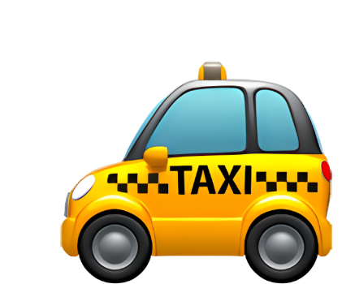

EXPENSES
Best Cities for Workation (simpelaki.github.io)

Slide 6
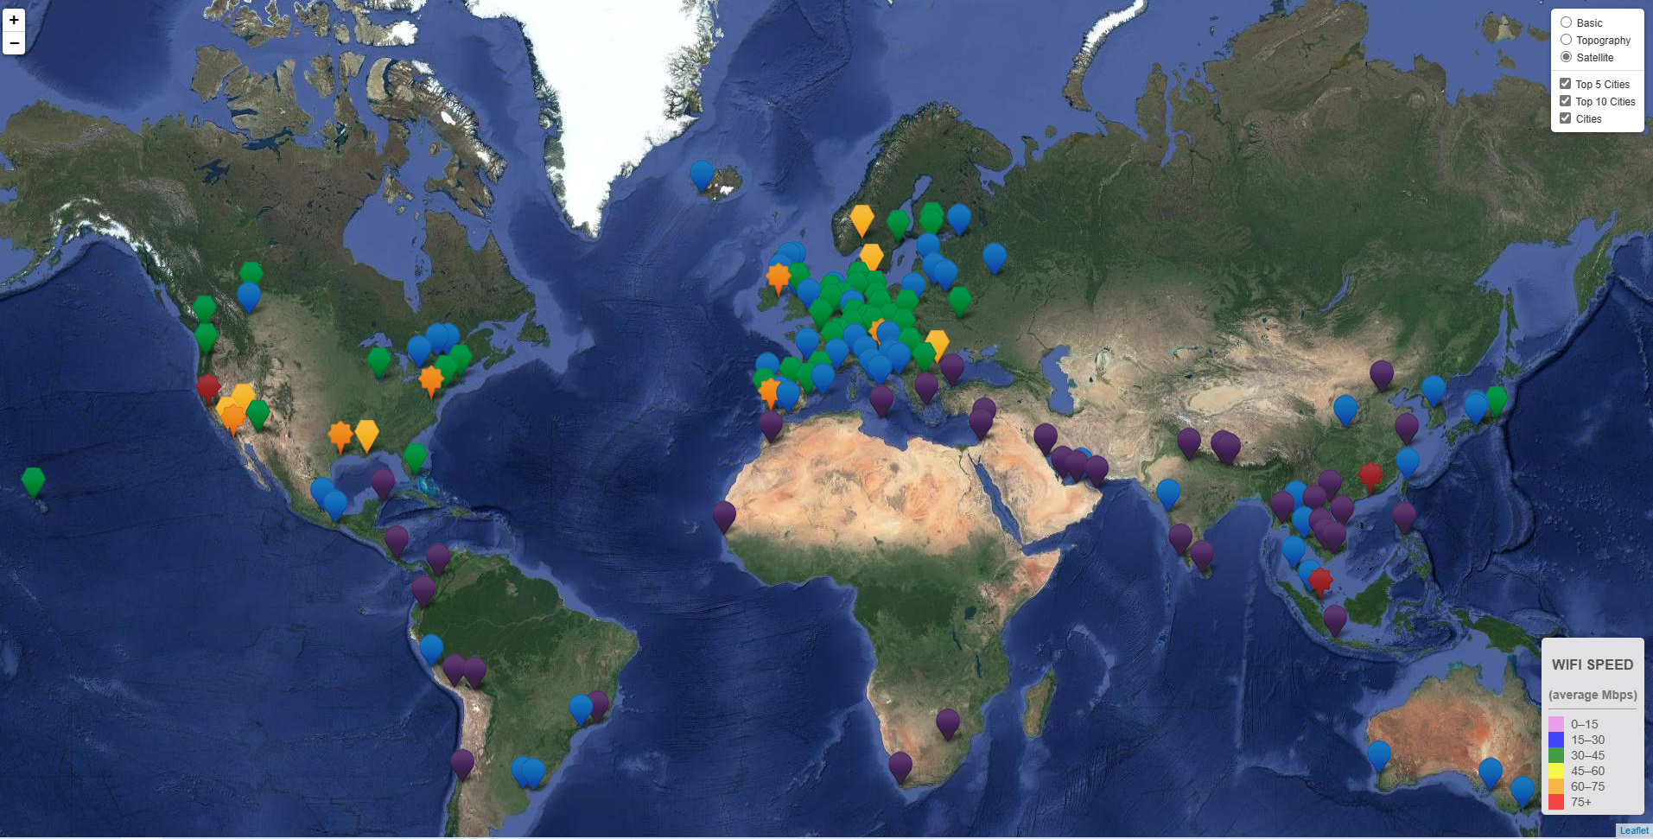
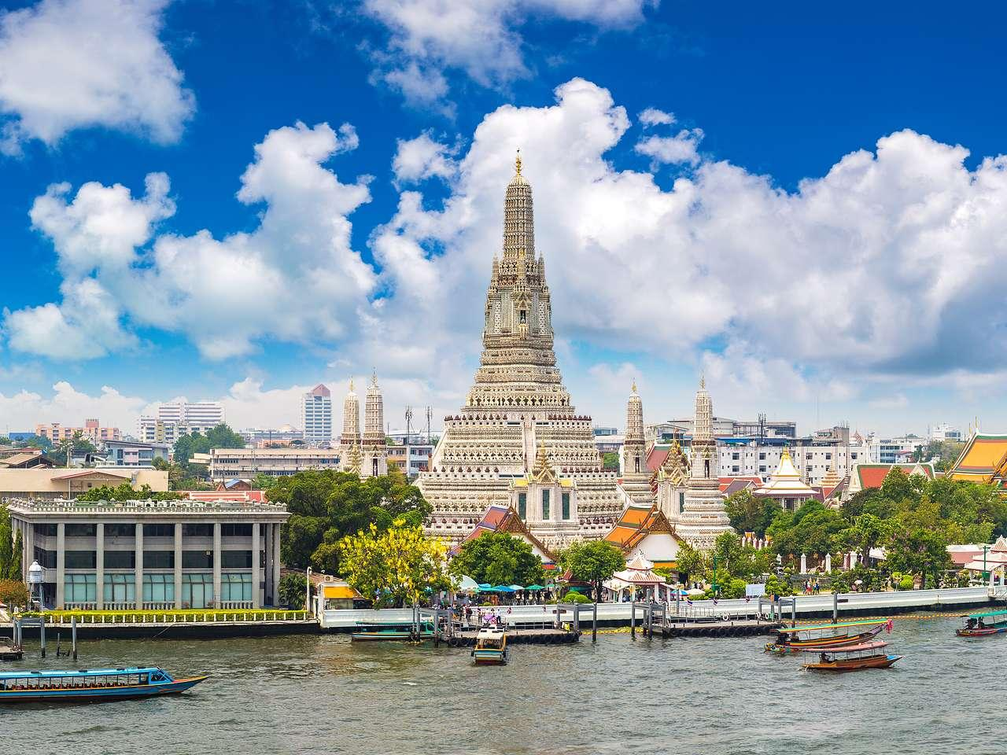
Top 5 cities for work are:
Bangkok, Thailand
New Delhi, India
Lisbon, Portugal
Barcelona, Spain
Buenos Aires, Argentina
Common factors: expenses are less, climate is high.
website
Best Cities for Workation (simpelaki.github.io)

Slide 7
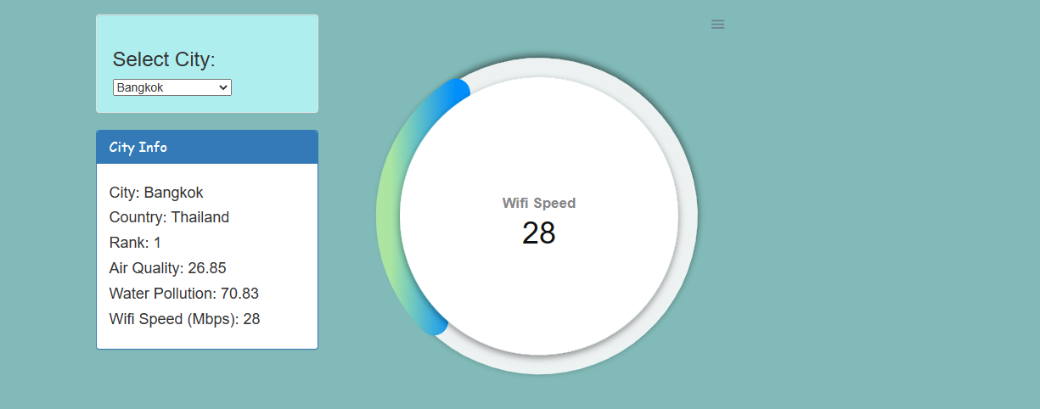
Wi-Fi SPEED
Best Cities for Workation (simpelaki.github.io)

Slide 8
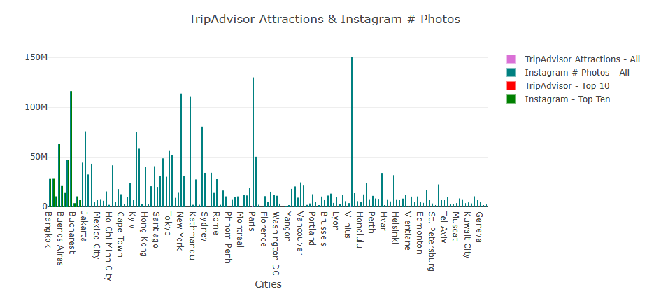
TOURIST ATTRACTIONS
Best Cities for Workation (simpelaki.github.io)

Slide 9
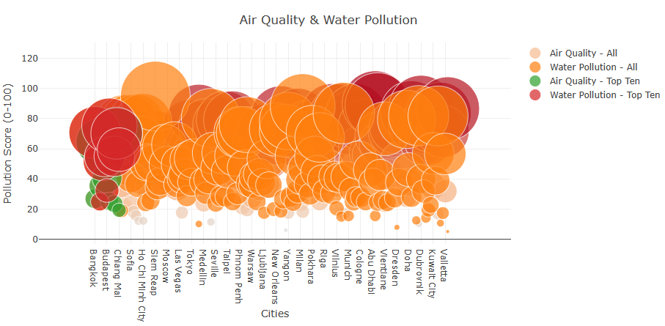
POLLUTION
Best Cities for Workation (simpelaki.github.io)

Slide 10
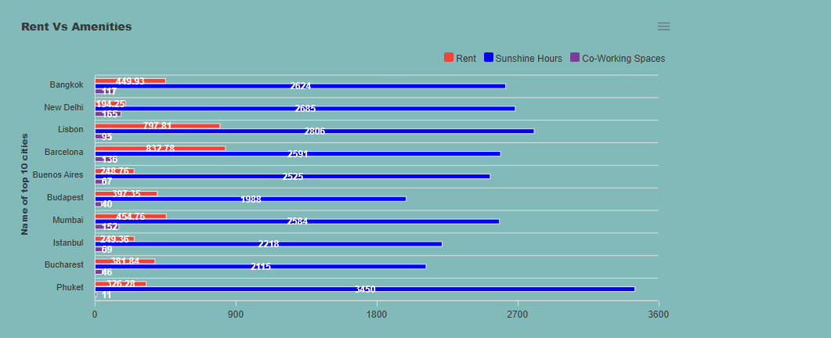
TOP 10 CITIES FOR WORKATION
Best Cities for Workation (simpelaki.github.io)

Slide 11
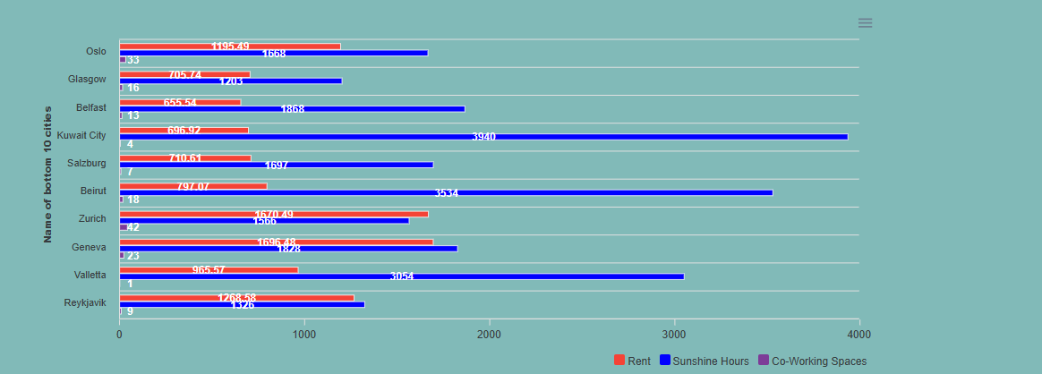
BOTTOM 10 CITIES FOR WORKATION
Best Cities for Workation (simpelaki.github.io)

Slide 12
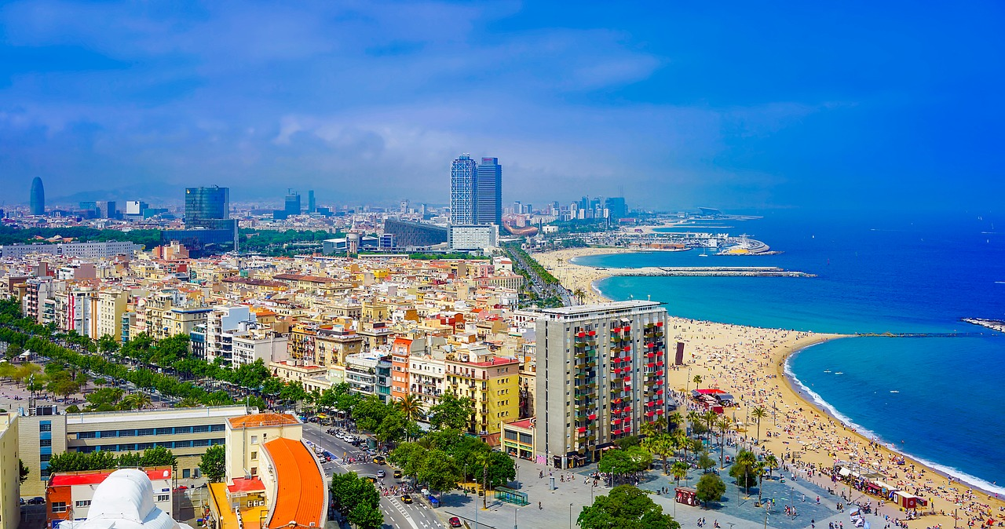
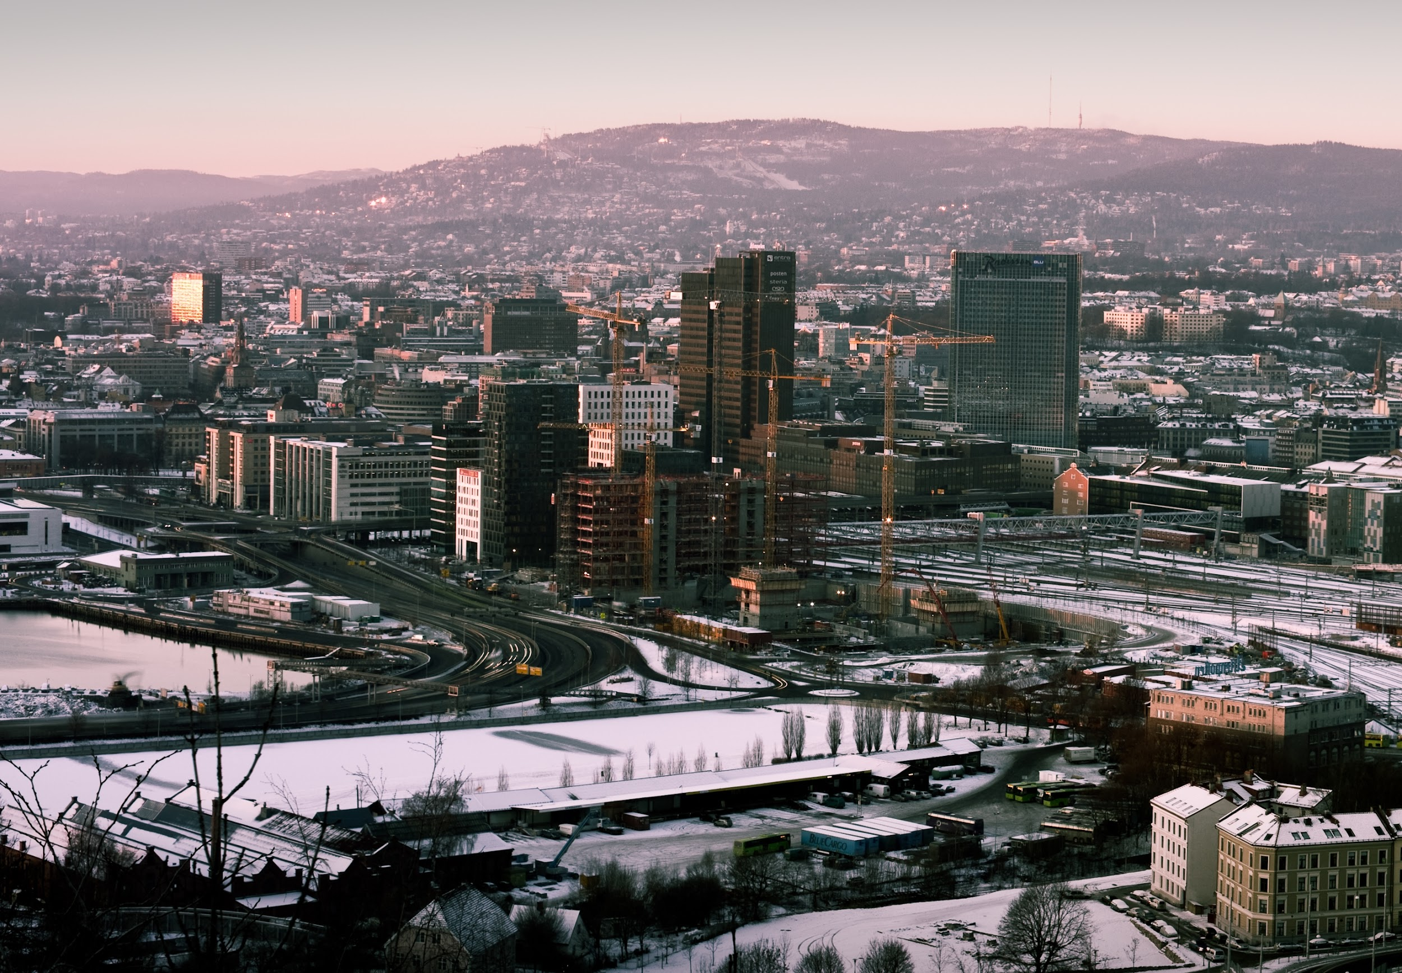
SUMMARY
“Workation” is most suitable where there is a positive correlation between “Low Expenditures” and “Higher Temperatures” within a destination.
Least ranked destinations showed a positive correlation between “High Expenditures” and “Lower Temperatures” within a destination.
Website
Best Cities for Workation (simpelaki.github.io)

Slide 13
Improvements
Most of the top cities are coastal cities where there are high levels of pollution. This wasn’t factored into the ranking criteria.
You can infer from the analysis the amenities in the top 10 cities are significantly different than the bottom 10 cities. There isn’t any metric to show the variability of amenities for each city.
For further steps we can do statistical analysis to strengthen our findings and look for more correlations in the data set.

Slide 14

References:
https://www.kaggle.com/datasets/cityapiio/world-cities-air-quality-and-water-polution
https://www.kaggle.com/datasets/prasertk/the-best-cities-for-a-workation?resource=download

